Slide 1

Lecture 1. An Introduction to Competitive Programming. Advantages of being a competitive programmer. Stages of Technical Interview. Practice on arrays and strings.
Yeskendir Sultanov

Slide 2
An Introduction to Competitive Programming.
Programming is fun
Programming is an exercise for your brain
Programming is mental sport
Notes:
It teaches you how to think?. If you are a programmer you might have understood the deep meaning of these lines quoted by Steve Jobs and you might have also experienced that even after shutting your computer you keep on thinking about programming stuff or code you have written in your project. Once you enter in programming you just don’t learn how to code but you also learn the “art of thinking”, by breaking your code into smaller chunks and then using your logic-based creativity to solve a problem from different angles. Programming is fun, programming is an exercise for your brain, programming is a mental sport and when this sport is held over the internet involving sport programmer as a contestant then it is called Competitive Programming. Let’s check what Wikipedia says about Competitive Programming.

Slide 3
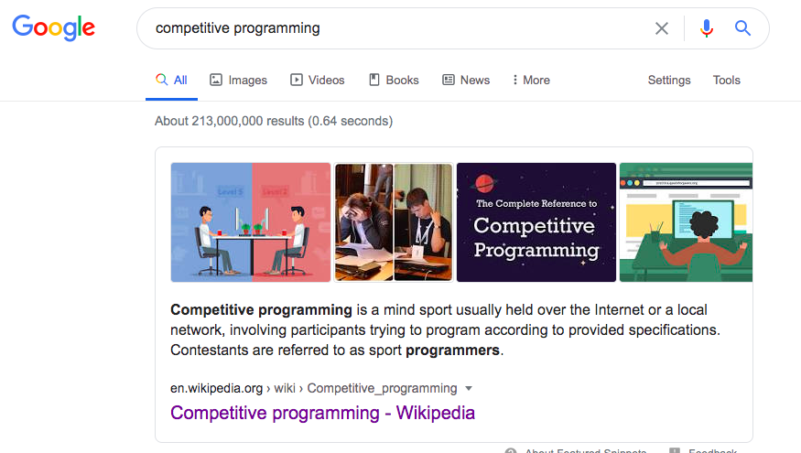

Slide 4
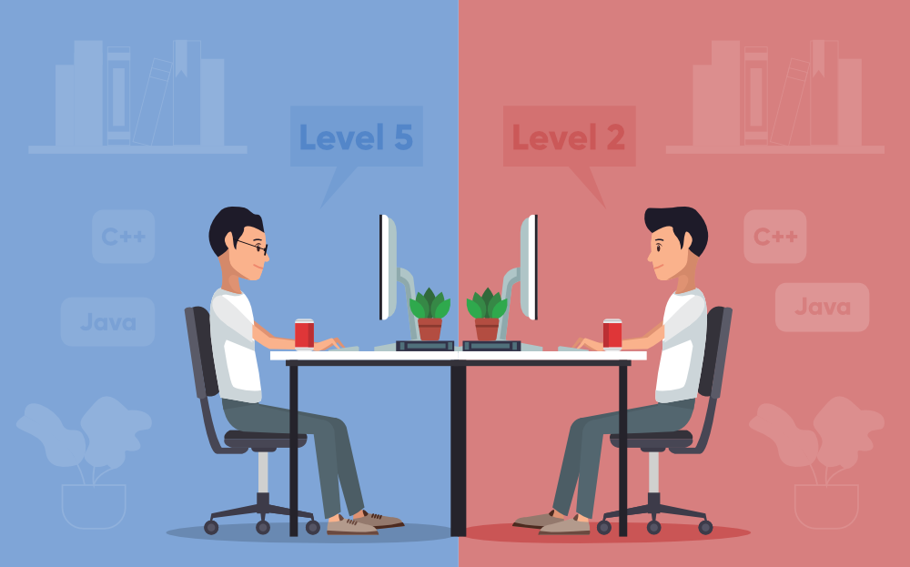
Why you should prepare yourself for this game and participate in it?
Choose any but highly recommended C/C++/Java
Time and space complexity algorithms analysis.
Ability to think about a Brute Force Solution.
Good practice of all Data Structures like Array, List, Stack, Queue, Tree, Graph, Trie etc.
Notes:
Programming is a challenging role and once you enter this field you will encounter new challenges and you may have to solve some problems which no one has solved before or their solution doesn’t exist anywhere. At that time you are expected to come up with a solution in the least possible time using your problem-solving and logical ability. So the one and clear goal behind these competitive programming is “To prepare a programmer such that his/her logical ability increases and he/she is able to write code for the challenging situation.” Another reason is that a lot of big companies like Google, Facebook. Microsoft, Amazon hires through competitive programming so if you want to get into these companies then you really need to get your hands dirty in competitive programming. It doesn’t matter you are a newbie programmer or you have written some code before, we will tell you some steps, approaches, and tips to prepare yourself for competitive programming. Let’s discuss that in detail.
Keep in mind that you need to be proficient with the following: * Any programming language syntax (Choose any but highly recommended C/C++/Java).
* Time and space complexity algorithms analysis.
* Ability to think about a Brute Force Solution.
* Good practice of all Data Structures like Array, List, Stack, Queue, Tree, Graph, Trie etc.

Slide 5
How to prepare yourself for Competitive Programming?
2. Understand the Concept of Time and Space Complexity
3. Learn the Fundamentals of Data Structures and Algorithms
4. Take the Challenge and Solve Coding Problems
1. Choose a Programming Language
Notes:
How to prepare yourself for Competitive Programming?
1. Choose a Programming Language: Firstly, you need to choose a programming language that you are most comfortable with and learn its syntax. It can be anything C, C++, Java, Python or any programming language. Programming languages are a tool through which you can communicate to the computer and instruct what to do. C++, C or Java is a faster programming language in comparison to any other language also it is allowed to use in any coding challenge or interviews. So it’s good if you choose one out of these three still there is no restriction if you are comfortable with another language. If you are beginner you can go with python because it’s easy to learn and syntax are user-friendly. If you have at least intermediate hold on the anyone programming language you won’t face difficulty in writing the code using the syntax of it.
2. Understand the Concept of Time and Space Complexity: In most of the cases there is more than one solution that exists to a problem so you need to come up with the best solution i.e optimal one and that’s decided by how much time and space an algorithm takes to solve a problem. So it’s really important to learn about these two concepts to write an optimal solution for the problem.
3. Learn the Fundamentals of Data Structures and Algorithms: DSA is the heart of programming and you can not ignore it while solving coding problems in competitive programming. Array, Linked List, Stack, Queue, Tree, Trie, Graph, Sorting, Recursion, Dynamic Programming all these basic building blocks of DSA will help you to become a good programmer. The most important thing you need to know what, when and where to apply them. It means which data structure is suitable for what type of problem to get the optimal solution. You should know how to apply a perfect combination of both in the coding problem.
4. Take the Challenge and Solve Coding Problems: You have learned a programming language, you have learned time and space complexity and you have also covered the fundamentals of DSA, now it’s time to take the knife in your hand and kill the lion in the jungle. Yes…you need to take part in coding challenges on different coding platforms. Before participating in contest it would be great if you practice for some challenges on your own and then participate there. If you are looking for the resources of these coding platforms so alot of sites are there like Codechef, Codeforces, Topcoder, SPOJ. Here is the complete list of these sites on freecodecamp. Start from the basic level on these sites and once you build the confidence, get out of your comfort zone and gradually try to solve the complex problems. Below are some points you need to keep in mind once you start solving problems on these sites…
You need to understand the input, output and test cases on these platforms. Check the link Solving Problem on Codechef to solve coding questions on these platforms.
These platforms run your code on a lot of inputs then take out the output and store it in one place. They also have the authors code and the authors code is the correct code of the problem. They run the same set of input on authors code and create the outputs and after that, they match these two outputs. If these two outputs match then your solution is considered as accepted and your code should pass all the test cases to get accepted.
You may freeze out in the beginning once you see the problems on these coding platforms and think that you are not made for it or your thinking ability is not much higher to solve these questions. The reason is as a beginner you just know the syntax of the language and some basic loops or function, so when you encounter these challenges you freeze out and start doubting on your capabilities which you should not do that. You need to understand that there is a process to learn competitive programming and you have to move gradually from level 0 to the top level.
5. Practice and Do it Regularly: Your patience, dedication, and consistency are very important to become a good competitive programmer. Keep practicing the coding questions every single day on these platforms or you can also take the help of whiteboard to solve coding questions but the important thing is to do it regularly. Do not make a mistake to take a break from it once you start. Stick on it, no matter how difficult the problem is or how much time you take to solve a single coding problem. Participate in different coding competitions and learn from other programmers. Your daily practice makes you a perfect coder, good problem solver and you will be able to find a suitable data structure for a specific problem and that matters a lot in software development.
Tips:
As a beginner in competitive programming is like giving a paper of IIT to 5th or 6th standard student and then asking him to solve the questions. You will be feeling like the same once you know the syntax, loop, function, and everything but you are unable to solve those coding problems and that’s completely okay. Understand that every beginner go through this phase.
Higher the submission is, easier the problem is on these coding platforms so you can sort these question by a number of people who solved it.
Create communities and try to find like-minded people who have different skillsets so you can learn from each other, also if you are in college then make a team and participate in ACM ICPC.
You can download one of the application Code Buff that will help you a lot in getting the notification of competitive programming coding contests happening across so many different platforms. It also allows the user to set a reminder.
To jump in competitive programming you can follow an approach of project-based learning in which, once you know the syntax of the language and basic fundamentals, you can create multiple challenging projects and after making a lot of projects you will realize how logics work in development and that will help you to increase programming ability. After that, you can move to competitive programming and you will realize handling those questions of competitive programming is easier now and now you can do very well.

Slide 6

Notes:
Programming really needs a lot of patience, so don’t get discouraged or DO NOT GIVE UP IF YOU GET WRONG ANSWERS. This is the point where most of the people lose interest in programming. Keep trying for a day, week, months if a voice inside your head says that your method is right. If you can’t find a solution google it, ask for help if you don’t get the topic, read the various approaches that coders took to solve the problem but don’t quit. Also, you can read the solution only if you are completely sure that you have made a lot of effort and now you can’t do anything. But make sure to code again the same problem. You will start improving day by day only and only if you maintain your consistency and don’t stop.
The biggest mistake programmers make is probably getting discouraged and not practicing enough. Or practicing only on problems they feel they’re good at. – Derek Kisman, aka SnapDragon

Slide 7
Advantages of being a competitive programmer.
1. Makes you a desirable candidate to major companies
2. Makes you faster and more focused
3. Helps you solve complicated problems
4. Teaches you how to work in teams
5. Training and participation helps you prepare for a career in coding
Notes:
the top benefits of competitive programming when it comes to finding career success.
Makes you a desirable candidate to major companies
Participation in the ACM International Collegiate Programming Contest (ACM ICPC) is a great opportunity to be seen by Apple, Facebook, Google, IBM and many other authorities in the IT sphere. These major companies are constantly keeping track of these type of events and the participants to find talented employees. Why do they care about the ACM ICPC? Because it is the largest student programming contest in the world! Globally, this competition is considered the most prestigious and includes elite young programmers. In the past, companies such as Apple, AT&T and Microsoft have sponsored the contest. And, today, the contest’s main sponsor is IBM, who will often extend a job offer to the winners.
At this point in my career, I am tutoring learners and not taking part in any contests, but I still receive job offers. Even though I am not looking to join the corporate world, once a year, Google checks in to see if I am interested in working with them! However, I am truly focused on my work with ITMO and the students I teach.
Makes you faster and more focused
Training and taking part in programming contests make you more a more disciplined, faster and focused coder.
In the competition, you must solve problems in stressful situations and do it up against a deadline or you will lose. Taking part in competitive programming teaches you how to be more focused on the task and not only complete it quickly, but accurately. These skills are highly beneficial for any job, not just in coding.
I strongly advise you to not only take this course if you are interested in participating in a programming contest, but also to learn how to train yourself to be a better coder. Before my team won the ACM ICPC, for three and a half years, we spent up to 8 hours a week solving problems. Practicing is everything!
Helps you solve complicated problems
During the ACM ICPC, you must solve difficult tasks, which are not for ordinary programmers. While you are training, you learn how to solve these out of the ordinary tasks. This helps prepare you for a job because you can adapt and solve various types of problems, in various types of situations.
Teaches you how to work in teams
This is a very important skill, as most jobs will require you at some point to work in a team. Competitive programming helps you learn how to effectively work together, as you must work with others on your team to complete the same task. You learn how to assess your team members’ strength and weaknesses and effectively divide responsibilities between each other.
Additionally, each team has a leader, whether at the ACM ICPC or within an office. If you are in the management role within a team, then knowing how to motivate and organize your team members is key. For example, at the ACM ICPC, it is even important to arrange your team’s chairs in the right order to make sure you can work comfortably and effectively as a team.
Training and participation helps you prepare for a career in coding
It is not out of the ordinary to receive job offers from companies immediately after participating in a coding competition.
Participating in a coding competition is something you should absolutely highlight on your resume. As previously stated, having experience in competitive programming shows employers you can work in a team, solve complicated problems, work in stressful situations, manage time and deadlines and minimize errors. It also shows you are a disciplined, focused and fast, which are all indispensable skills.
Training for coding competitions is a great experience for all programmers. Enroll in How to Win Coding Competitions: Secrets of Champions today.

Slide 8
The four stages of Technical Interview.
1. Applying to the company
3. Onsite interviews
4. Offer and beyond
2. Online interview
Notes:
1. Applying to the company
First, you need to somehow get to the actual interview. Most of the time, you apply to the company you want, but sometimes recruiters may also reach out to you themselves.
This sounds simple, but, in fact, the process can be quite complicated. We will cover it in depth in the applying section.
2. Online interview
For software engineers, the first technical part in the interview is usually an online coding session (often also called "phone screen" interview).
The interviewer will call you on the phone or via online video call (on something like Skype or Zoom), and give you a coding problem that you will need to solve in about 45 to 60 minutes. You will also need to code your solution in an online code editor like Coderpad, HackerRank, or even simply in the Google Docs.
You will also need to talk during the whole process and discuss your solution with the interviewer – this also takes practice!
3. Onsite interviews
If you successfully pass one or two online interviews, you are then invited to the onsite interviews that are usually done in person in the office of the company you are applying to.
Onsite interviews usually consist of 3-5 coding and other interviews done on the same day. After that, the company will make a decision whether to hire you or not.
For onsite interviews, you may need to travel to the office of the company that may be in another country or even on another continent. Of course, the company will cover all expenses for you, and help you with visa and other possible issues.
4. Offer and beyond
If you successfully passed all interviews, congratulations! In most cases, this results in a job offer from the company. If you accept it, it's time to settle down all details, fill out all the paperwork, and get excited about your new job!
The best candidates usually pass interviews with several companies at the same time. This way, they increase their chances of getting a good job, and, if they have multiple offers, they can choose the best from them and even negotiate a better compensation (we will talk more about negotiation later).
I would totally suggest to also do this, and interview with multiple companies at the same time. If you are already spending time and energy preparing for the interviews, why not pass as many interviews as possible?

Slide 9
Interview types
Coding interviews
Behavioral interviews
System design interviews
Notes:
1. Coding interviews
In the coding interviews, you typically get one or two algorithmic problems that you need to solve in about 45 to 60 minutes. You also need to code your solution in the programming language of your choice and discuss your solution with the interviewer.
For software engineers, coding interviews usually take the majority of the interview process and are by far the most important. A good performance here is the deciding factor for getting hired.
2. Behavioural interviews
Behavioural interviews take a look at your personality and work related history, and consider things like how you work in a team or how you handled challenging work situations in the past.
At these interviews you may get asked questions like "What was the most challenging project you worked on and why?" or "What was your biggest failure during the time at the company X?". Also, the interviewer may go through your resume and ask very detailed questions about your work experience and past projects.
Behavioural interview can be a separate round of interviews, but it's also common to be asked similar questions during the coding or other interview rounds. For example, you may be asked to "briefly describe your previous experience", or just to "introduce yourself".
3. System design interviews
At the system design interviews, you are usually given a very big and vague design problem like "Design Twitter from scratch", and you need to share your approach in about 45 minutes. There is no single correct answer, and the purpose of these interviews is to test your experience working with the real software systems, and how much you know about these systems in general.
You usually don't code much during these rounds, but instead show your design and considerations on the whiteboard, and discuss your approach with the interviewer.
System design rounds are more common for the senior and more experienced candidates, while interns and new grads usually don't have them. But it's still important for everybody to keep them in mind.
Variations
Interview types described above should cover most of the cases, but sometimes there may be something different. For example, some companies ask you to complete a test project or participate in an online coding competition.
While it's impossible to anticipate all the possibilities, preparing for the interview types listed here should be enough most of the time. And it will also help in other possible scenarios. You should also research the company you are applying to to see how their interview goes.

Slide 10
Preparing for the Future
Internships
Competitive programming
Other
Notes:
What if you don't have interviews for the few years, for example if you are still a high school or college student? It's actually a great place to be in, and there is a lot you can do to prepare for the future. Let's discuss this here.
Internships
If you are a college student, it's a great idea to have an internship at some big company. You should definitely apply to Google, Facebook, and the like – it's very possible to get there no matter where in the world you are from!
Usually, internships are done after the second or the third year of the college, but sometimes you can do them even after your first year. So, it's a great idea to start preparing early.
Preparing for the internships is about the same as preparing for the real job interviews – interview format is practically the same, you still have to know algorithms and data structures, and solving problems on the Leetcode is a great way to prepare. As a bonus, the same skills will be helpful at the real job interview later, and interning at a big company is one of the best ways to get hired by it later.
I know many people who didn't do any internships just because they didn't apply or thought it's impossible to get to the famous big companies. So one of the most important things you need to know is that it's possible, and you should go for it! Just don't miss application deadlines ;)
Competitive programming
One of the most useful activities for the interviews that you can do in advance is to start participating in programming olympiads, or, how it is often called, competitive programming.
Competitive programming is also focused on solving algorithmic problems. Problems there are usually much harder than typical interview problems, so after that interview problems will seem much easier.
To get started with competitive programming, you can watch this video, or start reading Competitive Programmer’s Handbook. I can also recommend Codeforces and AtCoder as two best platforms for competitive programming right now.
Participating in these olympiads is especially rewarding when you are a high school or a college student. It's a great way to meet other smart people, and you may win a right to participate in many international olympiads – travel covered! Even at the regional or country level, good participants often receive cool prizes and even university grants for free tuition.
From my experience, most competitive programming participants who are at least somewhat good usually easily pass interviews later, and end up working for the big international software engineering companies.
Other
There are other things you can do in advance. For example:
Take an algorithm course in your university or online.
Working on some personal project is a great way to become a better software engineer.
Find other cool people interested in algorithms and software engineering. You can prepare together, or just simply encourage each other to be better software engineers.
If you don't have interviews to pass right now, it's great – you have a lot of time to prepare in advance. Use it wisely!

Slide 11
Applying to companies
When to apply
How to apply
Referrals
Apply to many companies
Where to apply
Other ways to apply
Application specifics
Notes:
Applying to the companies is the first step in the interview process. It sounds rather simple, but in reality it can be pretty random and complicated.
Applying and getting to the interviews is an art of its own. Sometimes you have to wait for the response for weeks, sometimes you get rejected without any obvious reasons, sometimes you don't even get any answer back. Remember that it often doesn't really depend on you. Recruiters may have forgot or neglected your case, company could not hire during this particular period for some reason, or you just got unlucky. Be patient, and remember that it's a long game.
When to apply
Interview process can take months. So if you want to interview, apply early. After you get connected to the recruiter, you can often ask for as much time as you want (even months) for the preparation before the first interview round.
On the other hand getting connected to the recruiter can take weeks, so applying at the last minute can not work out.
How to apply
Companies have career pages on their website where you can browse teams and open positions, and apply for the job. Use these to look at what teams and positions are available, but applying there is not really effective – remember that thousands or millions of people use this page as well, and there are just too many applicants.
So how to apply instead? Use referrals.
Referrals
Referral is when a person working in the company submits your application (usually resume and some extra information) to the recruiters. This person basically recommends you for some positions at the company.
In the case of referrals, number of applicants is much smaller, and recruiters actually look at each application very carefully, so the chances of getting to the interview are very high, as long as your resume is decent.
Referral is basically the best way to apply to any company. Find friends and friends of friends who work in the company you want, and ask them for the referral. They will usually be glad to help.
Actually, in most big companies people working there get a monetary bonus for successful referrals (when the applicant got a job). These bonuses are often quite big, in the range of thousands of dollars. So, most people are very glad to refer somebody – you help a person to potentially get a job, and may get a lot of money for it, so why not?
This also means that you shouldn't be too shy asking somebody for a referral. Ask a friend, a friend of a friend, or even somebody that you kind of know, but never talked to. As long as you are polite, referrals are mutually beneficial, and most people are glad to help. It also usually takes about 5-10 minutes to refer somebody.
Apply to many companies
Since preparing for the interviews is a big investment of your time and energy, it totally makes sense to apply to many companies at the same time. This way you will have more chances to succeed, and with multiple offers at hand you can also negotiate a better compensation.
Also, you need to be "in shape" to successfully pass you interviews, so scheduling them at the same time will help you to do them all at your peak form.
Where to apply
Which companies to apply to? Short answer would be to apply to all that you can. Also, look for what you find interesting.
Here is also the list of some companies where you should apply and where there is a good chance of getting to the interviews. Most of these companies also have offices in several countries.
GoogleUberAirbnbSpotifyFacebookLinkedinMicrosoftYandexAmazonTwitterYelpBookingAlso, you should research the company you apply for. This will help you to learn the company better to see if it will be a good fit for you, and knowing the company well will also help you at the interviews. Apart from the usual Google and Wikipedia, here are some helpful links:
Glassdoor is a platform with employee reviews and other details for different companies.
Blind is an app and website where employees anonymously discuss their companies and a wide variety of other topics.
Levels.fyi – here you can compare levels and compensation in different companies.
Other ways to apply
Keep your LinkedIn updated. It is a good way to get contacted by the recruiters.
You can try solving coding challenges on CodeSignal to get contacted by the companies.
Application specifics
Your process depends on your level of experience:
Students and recent grads usually can only apply to internships and new grad positions respectively.
Experienced people, with 3-5+ years of experience, usually can get interviews almost anywhere.
A lot of positions require something like 3+ years of experience, so with 1-2 years of experience you fall somewhere in between of the two cases above, and the choice can be somewhat limited. It may be harder to get to the interviews, especially at the smaller companies.
Generally, it's also harder to get interviews with small companies because they don't have as many employees. If you are applying to the company in other country, and are looking for relocation, big companies are also much more likely to consider you and to help with visa and other immigration procedures.

Slide 12
Intro to Coding interviews
How to prepare
Learning algorithms
Knowing you language
Coding interview tips
Notes:
In coding interviews, you will typically get 1-2 algorithmic problems, and 45-60 minutes to solve them. You will need to explain your solution to the interviewer, and to write a solution code in the programming language of your choice.
Coding interviews usually take at least 80% of the whole interview process, and by far are the most important rounds of the interviews. Good performance here is a requirement for getting hired. Conversely, bad performance on the coding rounds can tank the whole process.
How to prepare
The best way to prepare for coding interviews is to solve a lot of practice problems in advance. For this, there is nothing better than Leetcode. Problems there are virtually the same as the ones asked at the real interviews in the companies. In my experience, about 25-30% of the problems I was asked to solve during the real interviews I solved on Leetcode before, and about 70% of the problems have similar problems on Leetcode.
I feel that anybody who solves 300–400 problems on the Leetcode has a good chance of passing almost any coding interview round.
Read more about using Leetcode
Cracking the Coding Interview book also has a nice collection of problems, though nowadays it's not as useful as Leetcode, where you can compile and test your solution. I mostly just checked the chapters I found interesting to me (for example, I recommend chapters about linked lists and trees).Learning algorithms
To solve interview problems you will also need to know a number of standard algorithms and techniques. You can learn more about it in the following section of this website:
How to Learn Algorithms
Knowing you language
In the coding inteviews, you will be expected to code a working code in the language of you choise. So, you need to pick a language you will use, and learn how to best use it. Learn about it here:
Picking a Language
Coding interview tips
There are many tips and strategies for a successful coding round. Read more about them here:
Coding Interview Tips

Slide 13
Picking a Language
Style guide
Getting good at the language
Learn your libraries
Learn from others
Notes:
In the coding interviews, you are expected to code a working solution in a language of your choice in 45–60 minutes. To do so, you need to practice, but first, you will need to choose which language you will be using and stick to it.
In most companies, you can use any language you want, as long as it's not very esoteric and rare.
The best choices for interviews are probably Java, C++, and Python. You can use them virtually in all companies (as long as the position is not language specific), and they are well suited for the interviews. Also, there are a lot of great resources and interview problem solutions in these languages, and this will be helpful in the preparation.
Some other languages you may consider using if you are comfortable with them are Swift, Kotlin, Go, and JavaScript, but I would recommend it only if you have a lot of prior experience with them.
Style guide
Once you pick your language, I would suggest reading some style guide for that language, and then following it. This way you will learn some good established practices, and won't debate choices about how to best write something.
Google has good style guides for Java, C++, Python, and some other languages, that I recommend:
Google Java Style Guide
Google C++ Style Guide
Google Python Style Guide
Getting good at the language
Whatever language you pick, I recommend you learn it well and become pretty good at it. In fact, your coding interview may have some language specific questions testing how well you know your language.
Learning the details of the language will also definitely make you a better software engineer, and prepare you for the interviews.
One of the best ways to learn the language well is to read some great book on it. Here are some books I recommend:
Effective Java – best book on Java, and I would recommend reading it even if you mostly use some other language.
Effective C++ – a classic book on C++.
Learning Python: Powerful Object-Oriented Programming – this seems like a good book on Python, but I have never actually read it.
Learn your libraries
Modern programming languages have a lot of built-in libraries for algorithms, data structures, and other tasks. It's better to use them whenever possible, than to reinvent the wheel: this will save you time, and built-in libraries are usually very well-tested, so this will save you a lot of bugs as well.
Learn libraries in the language of your choice, and try to use them when solving the interview questions.
Learn from others
Even if you solved the problem yourself, it's a good idea to see how others did it in your language. This way you can learn a lot of small techniques and patterns that you may have missed, and get better at you language.

Slide 14
Leetcode
How to solve problems on Leetcode
How to pick problems on Leetcode
Practicing speed
Leetcode contests
Other Leetcode features
Leetcode premium
Notes:
Leetcode is a website where you can solve interview questions and read some other interview related materials. It's probably the best way to practice for coding interview rounds.Problems on Leetcode are virtually the same as the ones asked on the real interviews in the companies. When I passed interviews, about 25-30% of the problems I was asked I solved on Leetcode before, and about 70% of the problems had similar problems on Leetcode.
I feel that anybody who solves 300–400 problems on Leetcode has a good chance of passing almost any coding interview round.
How to solve problems on Leetcode
There are several tips for the most optimal problem solving on Leetcode:
Avoid using IDEs or any code editors, and solve the problem right in the web editor on the Leetcode page, or on the whiteboard. In the real interview you won't get to write your code in the real IDE as well – in fact, you may need to write it on the whiteboard or in something like Google Docs.
Don't rush to see the solution too fast – allow yourself sometime to think about the problem. If you are stuck, it's ok to spend several hours or even a day to think about the problem before giving up.
After you solved the problem, be sure to check its official solution (if available) and several top solutions from the discussion page. This way you may learn about some better ways to solve the problem. Also, check some other solutions in your language of choice to see what you may learn from them.
Be sure to write a good code in your solution. Generally, during interviews you are expected to write a clean, well-styled code, like something that you may write at work, and not just any code that works.
How to pick problems on Leetcode
There are more than a thousand problems on Leetcode, but not all of them are great. Here is some advice on how to pick the problems to solve:
Problem difficulties are not always accurate, so don't skip easy problems. They also may have some interesting patterns that can help in harder problems.
Hard problems, on the other hand, are often too complicated and tedious, so solve them only when you are comfortable with easier problems, and mix them with easier problems as well. Before my interviews, I solved 333 Leetcode problems – 115 easy, 160 medium, and 58 hard.
For choosing what to solve next, I recommend if possible filtering by company tags (choose companies you want to apply to), and frequency. The following problem lists are also pretty good: Top Interview Questions, Top 100 Liked Questions, Top Google Questions, and Top Facebook Questions.
Problems with numbers bigger than 800 usually come from Leetcode contests, and are of a lower quality. They also usually don't come from real company interviews, so I don't recommend solving them.
For practicing particular algorithms and techniques, I suggest solving problems from the Algorithms section of this website.
Practicing speed
In the real interview, you are often expected to solve 2 problems (or a problem and a follow up problem) in 45-60 minutes. Besides the ability to solve problems, you may find that solving them fast is also important. Here are some tips how you may practice your speed:
You can solve problems as usual, but also have a dedicated speed training practice sessions. Choose two random problems (or two problems with the diffuculty you want to practice), and try to solve them as fast as possible – ideally, try to solve them in about 45-50 minutes. Be sure to still write a good quality code, and you can also practice explaining your solutions during this time (even if you explain it out loud to yourself).
Leetcode contests are all about speed, so you can try participating in them as well.
Leetcode contests
Leetcode hosts about 1-2 contests a week with brand new problems. These are fun to participate, and they may be helpful to train your speed. On the downside, problems in the contests are of a bit lower quality. Also, speed required to participate well in the contests is like 2-3x of what you need in the real interviews, and problems may be harder than usual interview as well.
If you participate, be sure to still write a good, clean code (it should be a general habit), and don't be too upset if you don't perform that well. Leetcode contests are hard, and are not directly related to the interviews – participate only if you are already comfortable solving problems and want to challenge yourself.
Before my interviews I participated in nine Leetcode contests, and was on the 24th place in the global ranking at that time.
Other Leetcode features
There are a lot of other Leetcode features – mock interviews, articles, and so on. Try all of them, and see what you find useful.
Leetcode premium
There is also a Leetcode premium subscription that opens you more features and problems. I found it only somewhat useful – the most helpful features to me were company problem lists and frequency feature.
Leetcode premium is definitely not required to prepare well for the interviews. And if you try it, generally it's enough to buy it for just 1-2 months. For example, you can buy it one month before your planned phone or onsite interviews. As a bonus, paying for the Leetcode premium subscription can be additional motivation to practice more during the time you have it.

Slide 15
Coding Interview Tips
Problem solving approach
Read or listen to the problem statement carefully.
Ask clarifying questions and think of edge cases.
Build some examples.
Think about straightforward solution.
Think of and discuss the optimal solution.
Think how your code would look like before implementing it.
Handle bad inputs and edge cases.
Check the code after you are done.
See if anything can be improved.
Coding style
Use good names for your variables and everything else.
Check input parameters.
Keep your variable scope limited.
Use the right keywords.
Preparing for interview types
Phone/online interviews
Onsite interviews
Mock interviews
Notes:
There is much more to the coding interviews than just the ability to solve problems. In this section, we will talk about some tips on passing your coding interviews.
Problem solving approach
The following steps will help you to better approach the problems during the coding interviews. This applies to both phone and onsite interviews.
Read or listen to the problem statement carefully. Understanding problem statement correctly is very important, so pay attention. You may also want to write some details down.
Ask clarifying questions and think of edge cases. After you understood the problem, ask the questions you may still have to clarify everything. Think of the edge cases. What if is the input is empty, or too big? Is it guaranteed to be X? Do we care about Y? Clarify everything with the interviewer. Thinking about edge cases ahead is much better than stumbling upon them during coding, or completely forgetting them.
Build some examples. You may still want to build some examples of input and output to understand the problem better, and for the interviewer to confirm it.
Think about straightforward solution. Even if you know how to optimally solve the problem, think of all possible simple and stupid solutions first. Is it possible just to check all possible options? Maybe backtracking? Discuss simple solutions with your interviewer, their potential drawbacks and time complexity. Rushing to the complex optimal solution may show that you are optimizing too early, before even considering simple approaches. Also, it may turn out that your interviewer is fine with the more simple solution than the one you know.
Think of and discuss the optimal solution. So now, what is the optimal solution to the problem? Describe it to the interviewer, and discuss it with him or her. What is the time and space complexity? How would you implement it? A great question to ask here is "Is this solution good enough?". This will tell you if the interviewer is ok with your solution, or you need to think more. Also, don't rush to coding – you may want to ask something along the lines of "Do you want me to code this now?".
Think how your code would look like before implementing it. This will save you from needing to rewrite or modify the code along the way, and will save you time. Of couse, it's almost impossible to imagine the whole solution code beforehand, but think of how its main structure will look like.
Handle bad inputs and edge cases. In your code, be sure to handle bad inputs (null, empty structures, and so on), and all edge cases. Even if your interviewer may be fine with you not checking the inputs, doing so will show that you are an experienced and considerate candidate, thinking about production quality code.
Check the code after you are done. After you finished writing the code, check it once more, check that it works on your examples, and show it to the interviewer. Think if you need to consider more tests cases. Also discuss with the interviewer how you would test this code.
See if anything can be improved. How else could you improve your code? What could you refactor or change? Are there any possible improvements or modifications to the algorithm or the approach? Discuss this with the interviewer.
Coding style
It's important to write a good, clean code during the interview. Think of it as of the code your would write in the production system. Here are some particular tips on the code style:
Use good names for your variables and everything else. Even though you want to write code fast, it doesn't mean you have to sacrifice readability.
int b = 0; // bad int bestSum = 0; // good void go() {..} // bad void calculateBestSum() {..} // goodCheck input parameters. Like you would do in the production code, check the parameters passed to the functions and elsewhere.
int getMaxElement(List<Integer> list) { if (list == null || list.size() == 0) throw new IllegalArgumentException("Received an empty list"); ... } boolean isPalindrome(String word) { // Sometimes just returning true/false or some other value may be fine. // Ask your interviewer! if (word == null || word.length() == 0) return true; ... }Keep your variable scope limited. Never use global variables. Keep the scope of the variables as small as possible.
// BAD class Solution { int[][] matrix; public int processMatrix(int[][] matrix) { this.matrix = matrix; ... doSomething(); doSomethingElse(); ... } private void doSomething() { /* use matrix */ } private void doSomethingElse() { /* use matrix */ } } } // GOOD class Solution { public int processMatrix(int[][] matrix) { ... doSomething(matrix); doSomethingElse(matrix); ... } private void doSomething(int[][] matrix) { /* use matrix */ } private void doSomethingElse(int[][] matrix) { /* use matrix */ } } }Use the right keywords. Learn what keywords like private, static, final/const, public and others mean in your language, and use them. Generally, you should mark your variables final when possible, and keep your functions and variables as private as possible.
class Solution { public int processMatrix(int[][] matrix) { ... final int matrixLength = matrix.length; // it should never change, so use final here processMatrixHelper(matrix); ... } // This helper function should not be called from outside, so mark it private. private void processMatrixHelper(int[][] matrix) { /* use matrix */ } } }If you want to learn more about writing a good code, consider reading Clean Code and Effective Java. They should help a lot.
Preparing for interview types
Phone/online interviews
A lot of phone interviews happen in Google Docs or something like coderpad.io. You can practice writing code there.
Make sure you have a reliable internet and, if needed, phone connection, good headphones with microphone, and a quiet place where you can be alone for the whole time. For me, I found that the best time to do phone interviews is the first thing in the morning (after some breakfast of course), but you may see what works best for you. Interviews are pretty nervous experience so you want to make yourself as comfortable and relaxed as you can.
Onsite interviews
In a lot of onsite interviews you will code on a whiteboard. Writing code on a whiteboard is pretty different from coding on the computer, so you may want to get an access to or buy the whiteboard, and practice writing code on it closer to your onsites. Watch for things like how you manage your space on the whiteboard, and how you edit the code on it.
Onsite interviews are physically and psychologically demanding, so you should take at least one rest day before and between them. I'd suggest taking something like one-two weeks off specifically to do onsites, and not to do more than three of them per week.
Be sure to bring the stuff you may need with you to the onsites. Stuff like water or a drink of choice, laptop (in case you may be allowed to code on it) with charger and everything, some snacks (or even a lunch if needed), markers for the whiteboard (good to have just in case), tissues and personal products, and so on. This will cover you in case you need something, and make you less nervous.
Several days before onsites it's probably more effective to review past problems and solutions, than to solve a lot of new problems. And it's probably better just to rest on the last day before the interview.
Mock interviews
From the practice, the only way to be less nervous during interviews is to do more of them. Of course, you don't want to practice on the real interviews at the companies of your dream, so doing a lot of mock interviews beforehand is another good option.

Slide 16
Learning algorithms
Where to study algorithms?
Introduction to Algorithms by Cormen
Competitive Programmer’s Handbook by Antti Laaksonen
Cracking the Coding Interview by Gayle McDowell
CP-Algorithms.com
Solve problems
Notes:
In the next sections we will study various algorithms and techniques asked in interview problems. But before we dive in, let's discuss how to actually study algorithms.
Learning a particular algorithm for the first time always takes time, so don't rush it. Be sure you understand the core principles of the algorithm you are studying. Try to write your own code from scratch. Ask questions like: why is this algorithm needed? What are its defining characteristics, how is it different from other algorithms? When is it useful and why?
Where to study algorithms?
Thankfully, there are a lot of resources available for studying algorithms. Often, to find what you need it's enough just to check Wikipedia or do a quick Google search.
Here are some more great resources I recommend:
Introduction to Algorithms by Cormen, et al – probably the best book on algorithms. It's very precise, mathy and dives deep into the heart of algorithms. When you want to deeply understand some topic in and out, this is the best resource for it.
Competitive Programmer’s Handbook by Antti Laaksonen – targeted for competitive programming, this book gives very succinct and clear explanations of many common algorithms used in the interview questions as well. Also, unlike Introduction to Algorithms, that provides only a pseudocode of algorithms, Competitive Programmer’s Handbook contains clean working implementations in C++ for a lot of algorithms it describes. The book is available free online. Also it has a companion set of problems, that you can try if you are feeling adventurous :)
Cracking the Coding Interview by Gayle McDowell also has a lot of nice descriptions of interview problems and algorithms.
CP-Algorithms.com provides detailed descriptions and implementations for a lot of algorithms, especially harder ones.
Solve problems
Of course, the best method to learn algorithm is to learn how to use it. For this, practice the algorithm on various related problems. You can find recommended problems for each topic in the next sections.

Slide 17
Arrays
Arrays are one of the most important building blocks in your solutions. In this section, let's practice problems with arrays and study some related techniques.

Slide 18
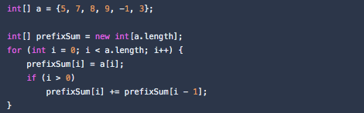
1D arrays. Prefix sums
Prefix sums are one of the most important techniques with the arrays. Here is how you build prefix sums arrays:
=
Note how prefixSum[i] here keeps sum of the initial array elements from indexes 0 to i.
Not sure yet how this may be useful? Try solving this problem:

Slide 19
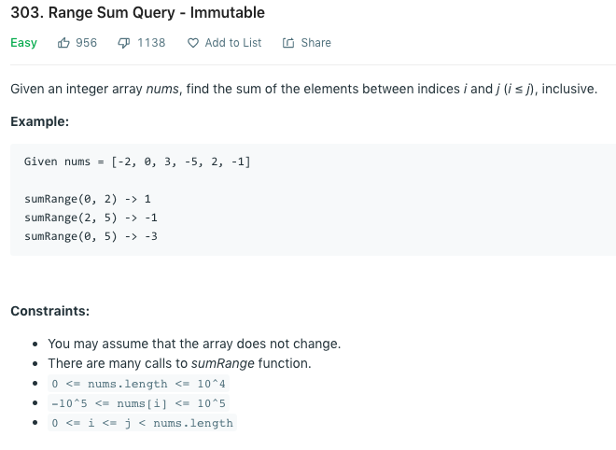

Slide 20
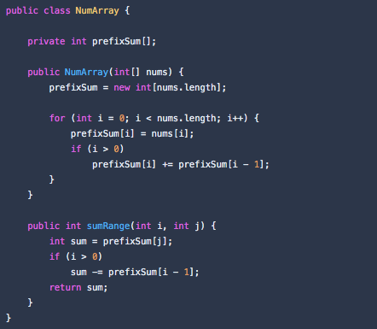
Leetcode.com 303. Range Sum Query - Immutable
Use prefix sums to get sum in the range fast.
Solution:

Slide 21
Strings
Strings are very common in the interview questions. In this section, we will cover some common string manipulation techniques, and solve some typical problems.
String concatenation
Parsing
Building a string

Slide 22
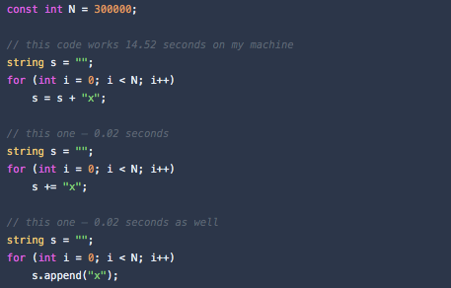
String concatenation
In C++, strings are mutable, but you still should be careful with concatenation. As a rule of thumb, you should use += operator or append method (they append to the original string object), and avoid + operator (it creates a new string object):

Slide 23
Lecture Quiz
What is competitive programming?
Enlist advantages of competitive programming.
What are the four stages of interviewing?
What are the coding interviews?
What are the behavioral interviews?
What are the system design interviews?

Slide 24
Thank you!

